Slide 1


Slide 2

Statistical Machine Learning (IT5428E)
Density Based Spatial Clustering of Applications with Noise
- DBSCAN -
Nguyen Viet Dung
Ngo Hien Duong
Hoang Van Cong
Hoang Thi Minh Nhat
Nguyen Van Duong

Slide 3
Contents
1. Introduction
2. Concept
3. Algorithm
4. Determining the Parameters Eps and MinPts
5. Performance Evaluation
6. Our Testing
2

Slide 4
1. Introduction
Name: Density Based Spatial Clustering of Applications with Noise
Partitioning methods
Hierarchical methods
Grid-based methods
Density-based methods

Slide 5
1. Introduction
DBSCAN compare to CLARANS: (Clustering Large Applications based on RANdomized Search )
* Results of experiment
DBSCAN is significantly more effective in discovering clusters of arbitrary shape
sdfsdf

Slide 6
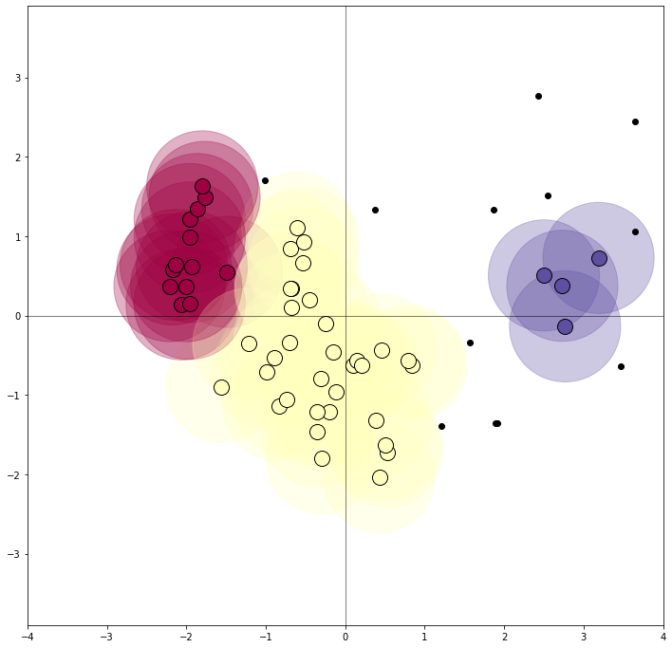
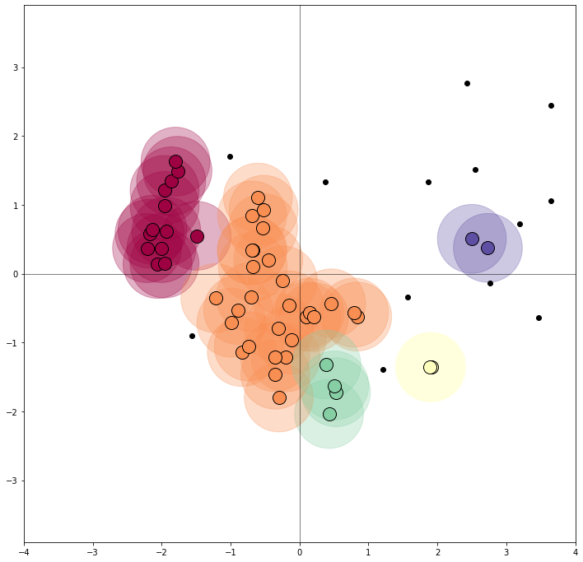
Results
EPSILON = 0.7
MIN_POINT = 4
EPSILON = 0.5
MIN_POINT = 2
1
2
number of clusters: 3
number of noise points: 12
number of clusters: 5
number of noise points: 13
2

Slide 7
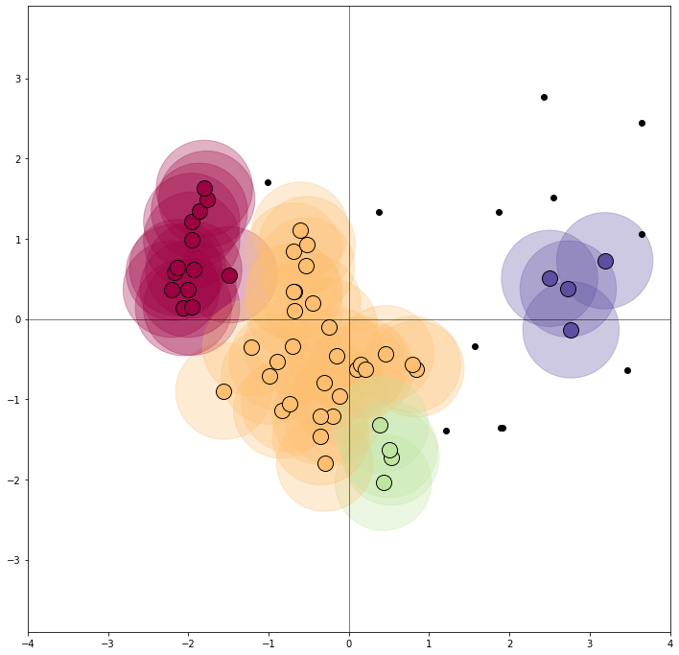
Results
EPSILON = 0.5
MIN_POINT = 2
EPSILON = 0.6
MIN_POINT = 4
2
3
number of clusters: 5
number of noise points: 13
number of clusters: 4
number of noise points: 12
2

Slide 8
4.2 Determining the Parameters Eps and MinPts
To determine the parameters Eps and MinPts of the "thinnest“ cluster in the database based on the following observation:
d : be the distance of a point p to its k-th nearest neighbor.
The d-neighborhood of p contains exactly k+1 points for almost all points
The d-neighborhood of p contains more than k+1 points only if several points have exactly the same distance d from p which is quite unlikely
Changing k for a point in a cluster does not result in large changes of d. This only happens if the k-th nearest neighbors of p for k= 1,2, 3 .... are located approximately on a straight line which is in general not true for a Point in a cluster.
3

Slide 9
4.2 Determining the Parameters Eps and MinPts
To determine the parameters Eps and MinPts of the "thinnest“ cluster in the database based on the following observation:
d : be the distance of a point p to its k-th nearest neighbor.
The d-neighborhood of p contains exactly k+1 points for almost all points
The d-neighborhood of p contains more than k+1 points only if several points have exactly the same distance d from p which is quite unlikely
Changing k for a point in a cluster does not result in large changes of d. This only happens if the k-th nearest neighbors of p for k= 1,2, 3 .... are located approximately on a straight line which is in general not true for a Point in a cluster.
3

Slide 10
4.2 Determining the Parameters Eps and MinPts
For a given k in a function k-dist from the database D to the real numbers:
mapping each point to the distance from its k-th nearest neighbor
sorting the points of the database in descending order of their k-dist values
the graph of this function gives some hints concerning the density distribution in the database, called this graph the sorted k-dist graph.
If choose an arbitrary point p, set the parameter Eps to k-dist (p) and set the parameter MinPts to k, all points with an equal or smaller k-dist value will be core points.
finding a threshold point with the maximal k-dist value in the "thinnest" cluster of D we would have the desired Parameter values.

Slide 11
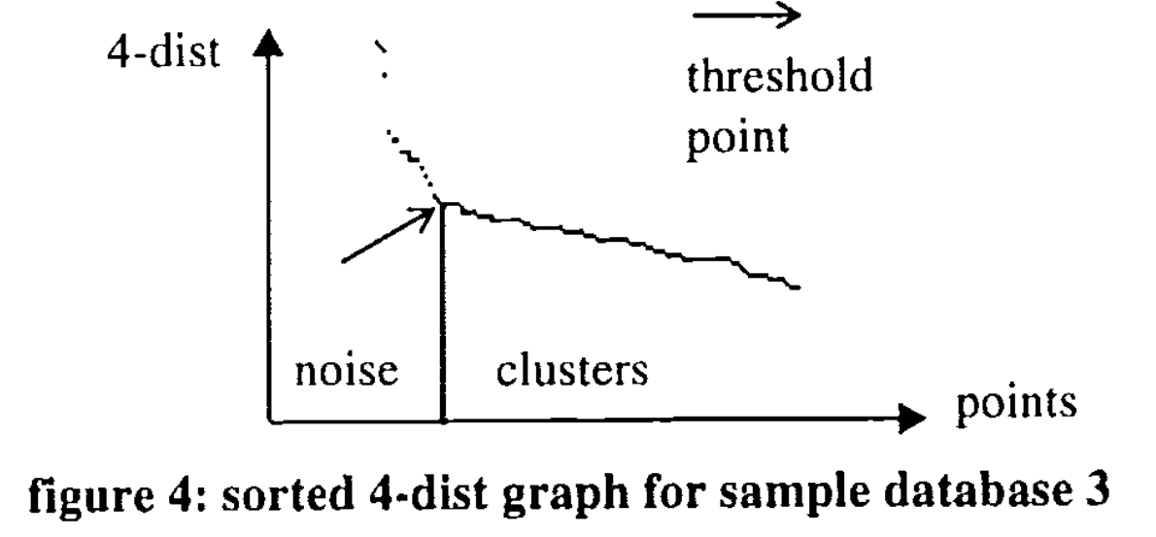
4.2 Determining the Parameters Eps and MinPts
The threshold point is the first point in the first "valley" of the sorted k-dist graph(see figure 4).
All points with a higher k-dist value (left of the threshold) are considered to be noise, all other points (right of the threshold) are assigned to some cluster.
In general, it is very difficult to detect the first "valley“ automatically, but it is relatively simple for a user to see this valley in a graphical representation.

Slide 12
4.2 Determining the Parameters Eps and MinPts
Building an interactive approach for determining the threshold point.
DBSCAN :
two parameters, Eps and MinPts.
In experiments indicate that the k-dist graphs for k > 4 do not significantly differ from the 4-dist graph and, furthermore, they need considerably more computation.
Eliminate the parameter MinPts by setting it to 4 for all databases (for 2-dimensional data).
We propose the following interactive approach for determining the parameter Eps of DBSCAN
The system computes and displays the 4-dist graph for the database
If the user can estimate the percentage of noise, this percentage is entered and the system derives a proposal for the threshold point from it.
The user either accepts the proposed threshold or selects another point as the threshold point. The 4-dist value of the threshold point is used as the Eps value for DBSC

Slide 13
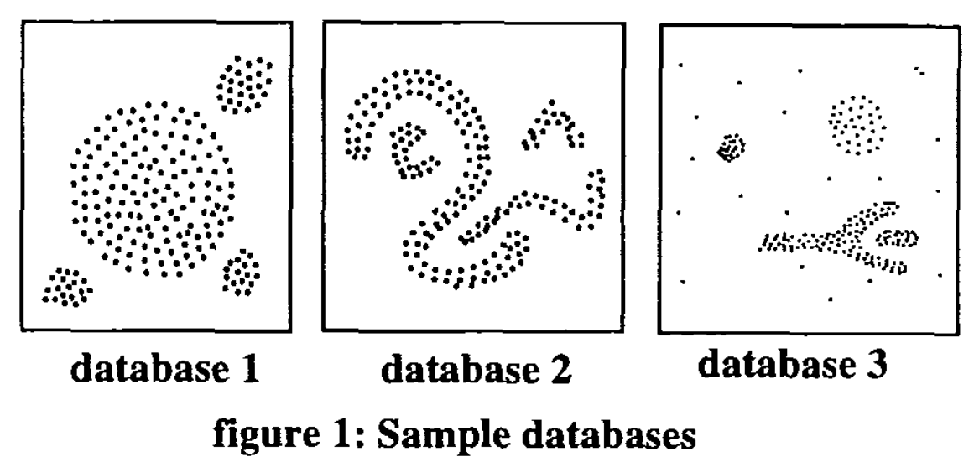
5. Performance Evaluation Comparing DBSCAN and CLARANS
Two clustering algorithms designed for the purpose of KDD (Knowledge Discovery in Databases)
All experiments implemented DBSCAN in C++based on an implementation of the R*-tree (Beckmannet al. 1990), run on HP735 / 100 workstations.
DBSCAN and CLARANS have no common quantitative measure of the classification accuracy, therefore, evaluate the accuracy of both algorithms by visual inspection.

Slide 14
5. Performance Evaluation The effectivity (accuracy) of DBSCAN with CLARANS
Testing databases: 3 sample databases use in paper
For DBSCAN
Setting: the noise percentage : 0%for sample databases1 and 2, and to 10% for database 3,
DBSCAN discovers all clusters (according to definition 5) and detects the noise points (according to definition 6 from all sample databases.
For CLARANS:
Splits clusters if they are relatively large or if they are close to some other cluster.
CLARANS has no explicit notion of noise. Instead, all points are assigned to their closest medoid.

Slide 15
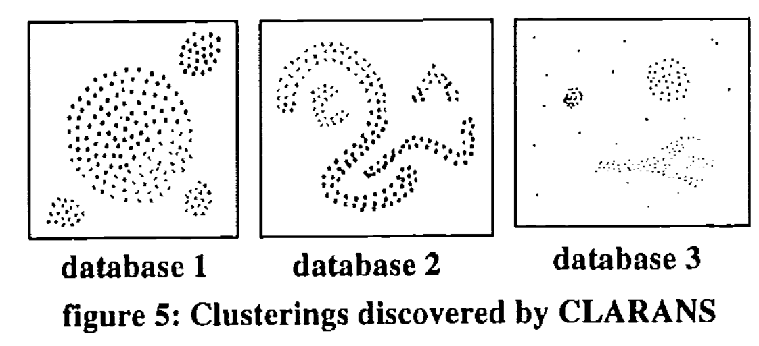
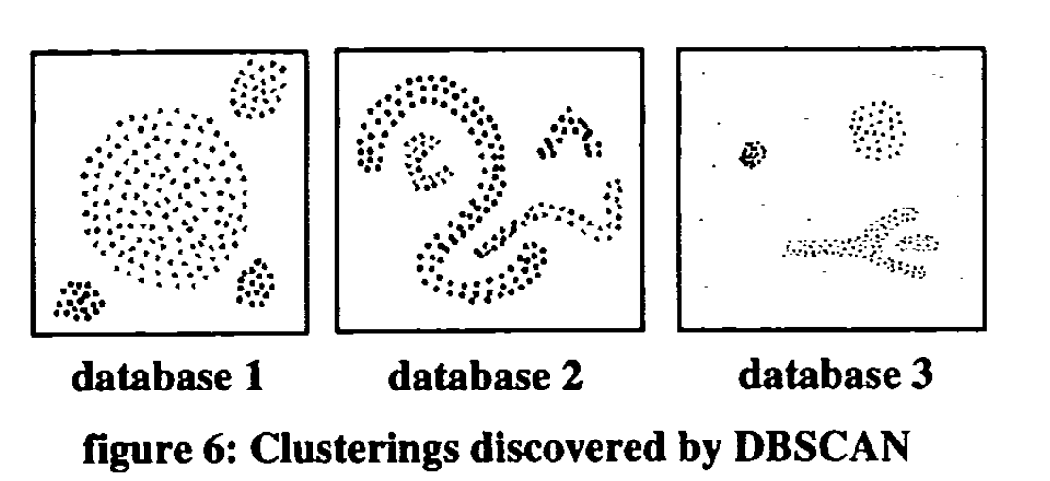
5. Performance Evaluation The effectivity (accuracy) of DBSCAN with CLARANS

Slide 16
5. Performance Evaluation To test the efficiency of DBSCAN and CLARANS
The SEQUOIA2000 benchmark data: using a series of subsets of the SEQUIOA2000 point data set containing from 2% to 20% representatives of the whole set.
4 types of data: raster data, point data, polygon data and directed graph data.
The point data set: 62,584 Californian names of landmarks, extracted from the US Geological Survey’s Geographic Names Information System, together with their location.
The point dataset occupies about 2.1 Mbytes.

Slide 17
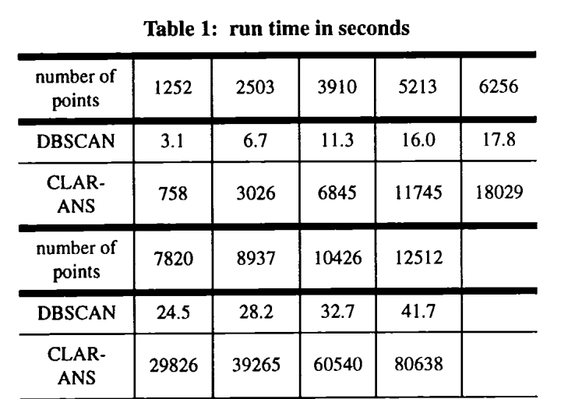
5. Performance Evaluation To test the efficiency of DBSCAN and CLARANS
Conclusion about the run time of:
DBSCAN is slightly higher than linear in the number of points.
CLARANS, however, is close to quadratic in the number of points.
DBSCAN outperforms CLARANS by a factor of between 250 and 1900 which grows with increasing size of the database

Slide 18
5. Performance Evaluation
DBSCAN is significantly more effective in discovering clusters of arbitrary shape than the well-known algorithm CLARANS
DBSCAN outperforms CLARANS by factor of more than100 in terms of efficiency

Slide 19
Our Testing Results

Slide 20

Questions
71

